Slide 2
Demand Management
Ignite World Wide Tour
Microsoft Corporation

Slide 3
Agenda
Overview of Demand Management
Enterprise Project Types
Project Workflows
Approvals
Phases
Stages
Project Detail Pages

Slide 4
Overview of Demand Management

Slide 5

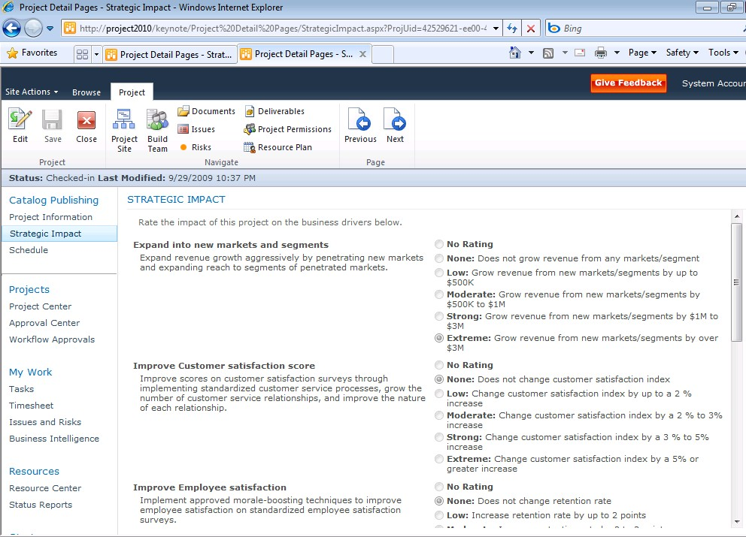





Unified Project and Portfolio Management Capture all work in a central repository
Capture all Requests
Control via Workflow
Build Business Case
IT Project Workflow
Work Request Workflow
Business Project Workflow
Strategic Impact Assessment

Slide 6

What is Demand Management?
Part of the overall Project Server 2010 solution
Part of providing a common user experience across PPM lifecycle
You can capture all work proposals in one single place
Workflows are a component of Demand Management which you can use to automate your existing business processes –optional, not required
You can create customized workflows as well as pages for displaying and collecting information from the end users
Workflows, along with other key concepts, are captured and integrated within the demand management feature set
Notes:
Demand Management is a piece of the over all EPM solution.
Demand Management is a feature we created to allow our customers to capture and observe all of their project and proposals in a single place
Workflows are a component of Demand Management which you can choose to leverage in order to automate your existing business processes.
This is a very big improvement from Project Server 2007 as you can now create customized workflows as well as pages for displaying and collecting information from the end users.

Slide 7



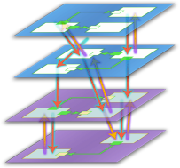







The Enterprise Project Management Solution
Four typical phases of demand management lifecycle
Enterprise Project Management
Create
Select
Plan
Manage
Demand Management
Portfolio Selection
Work Planning
Collaboration & Reporting

Slide 8
Demand Management
Capturing all “demand” (i.e. work proposals) in one single place
Making decisions on which proposals to approve and track progress
Project Server 2010’s support for Demand Management is flexible:
Simple projects that don’t require approvals and workflow
Complex projects with complex lifecycles involving multi-stage approvals and workflow

Slide 9
Demand Management Concepts
Enterprise Project Types
Workflows
Stages/Phases
Project Detail Pages
SharePoint/Custom Web-parts
Enterprise Custom Fields

Slide 10
End User Experience
Simple to use
Information collected in stages
Information split into convenient sections/links
UI similar to SharePoint
Can create proposals without schedule !
Powerful and flexible
One place to enter various types of work
Enhanced support for templates
Ability to track initiatives from start to end
Align demand requests with strategy
Standardized deployment, maintenance

Slide 11
Enterprise Project Types (EPTs)

Slide 12
How EPT’s are used in PWA
Enables project creation with template schedule, workflow, workspace
Can be filtered by user department
PM’s create new project or proposal using an available EPT in the Project Center
Governs project and proposal lifecycle
Administrator selects “Server Settings” -> “Workflow and Project Detail Pages”-> “Enterprise Project Types” menu to manage and create EPTs

Slide 13
Enterprise Project Type (EPT)
Typically EPTs are aligned with Departments
Examples: Different sets of EPTs, some for IT, others for HR, others for Finance etc.
PWA uses EPTs to group:
Project Detail Pages
0 or 1 Workflow
Phases
Stages
Required business case artifacts
Projects created using Project Professional will automatically be associated to the default EPT
Notes:
EPT = Enterprise Project Type

Slide 14
Out-Of-the-Box EPTs
Sample Proposal
Workflow driven
Basic Project Plan
Non workflow driven
How to Create New Project Site Template:
Create New Site (Site Actions | New Site | Microsoft Project Workspace)
When Finish: Go to Site Actions | Site Settings | Save Site as Template
Go to Site Settings | Galleries | Solutions, select Solution and Activate
Leverage New Template in EPTs

Slide 15
High Level Process to Create a Custom EPT
For a Workflow EPT Design your Workflow (create your Visio Diagram)
Create the custom fields you would like to use within your workflow
Create the pages that will display your custom fields and web parts
Create the Phases of your workflow
Create the Stages that will exist within the Phases, and will hold the pages that you defined
Create the workflow in Visual Studio
Deploy the workflow onto PWA
Create an EPT and reference the workflow you just created
For a Non-workflow EPT
Create required custom fields
Create the pages you would like to show up for this EPT
Create an EPT
Select no workflow
Indicate what pages to display

Slide 16
Demo - EPT Creation
Click “New Enterprise Project Type” and fill in the EPT creation page
Site Workflow Association may either be “No Workflow” or a workflow that satisfies the governance requirements of this EPT
Launch PDP is selected
Department may be associated
Possible here to override PWA default EPT
Notes:
click Server Settings
Under Workflow and Project Detail Pages, click Enterprise Project Types
Click New Enterprise Project Type
In the Name box, enter a name for the type, and a brief description in the Description box.
Select a workflow from the Site Workflow Association list. Once you associate a site workflow with a project type and save the type, you cannot go back and update the type to use a different workflow.
Select a project detail page from the New Project Page list.
If you selected No Workflow from the Site Workflow Association list, select the project detail pages that you want to include in this project type from the Available Project Detail Pages box, and then click Add to move them to the box on the right.
If the enterprise project type that you're creating is the one that all new projects should use by default, select the Use this as the default Enterprise Project Type during Project Creation check box.
Click the button next to the Departments field to select the departments you want to associate with this project type, if appropriate.
In the Order section, choose whether you want this project type to appear at the end of the list of project types, or if you want to control its placement in the list.
Select a template from the Project Plan Template list, if appropriate.
Select a template from the Project Site Template list, if appropriate.
Click Save to save this enterprise project type to the server, making it available for new project or proposal creation.

Slide 17
Project Workflows

Slide 18
Workflows
Not all EPT’s have to use workflows
Workflow supports more complex PM Lifecycle with multiple stages
Custom Workflows created in Visual Studio 2010
Project Server 2010 does not support workflows build with SharePoint Designer 2010
Allows for a custom approval process
Notes:
RTM = Release to Manufacturing

Slide 19
Overall Project Workflow Process
EPT’s are the starting point, PM initiates a project by picking an EPT in PWA
A series of one or more Stages need to be followed in sequence. Each Stage displays one or more PDP’s to collect/display info
Phases logically group sets of Stages
A Workflow, built in Visual Studio, must be associated with at least one Stage, exerting control on the sequence through definition of Approvals
Notes:
EPT = Enteprise Project Type
PDP = Project Detail Pages
PWA = Project Web Access

Slide 20
Workflow Stages and Phases
Vital component of the Project Lifecycle
Stage controls behavior
Visible Pages
Read Only, Required Custom Fields
Phase groups stages
Current phase, stage of project available in Project Center, Reports

Slide 21
Workflow Administration
After Workflows are built in Visual Studio, they need to be packaged up as solutions or features and loaded into the PWA site using stsadm/PowerShell or VS
Refer to the Project Server 2010 SDK help file for more information
Notes:
When deploying Workflows we recommend you deploy them as SharePoint Features.
This makes things simpler and easier both when installing, and subsequent updates

Slide 22
Changing an EPT mid-lifecycle
A project or proposal’s EPT may be changed in mid-lifecycle if necessary
Current workflow will end and new EPT’s workflow will begin from its 1st stage
New EPTs pages will be loaded
Save current page’s data prior to changing EPT

Slide 23
Phases

Slide 24
Phases
Collection of Stages grouped together to identify a common set of activities in the project life cycle.
Examples of Phases: project creation, project selection
Phases do not directly affect Project Detail Pages
Out Of The Box Phases:
Create
Plan
Select
Manage
Finished

Slide 25
Stages

Slide 26
Stages
Each Stage is one step in the project lifecycle
Stages are managed in PWA
Stage is composed of one or more PDP’s
Workflows may be linked to Stages within Visual Studio
Notes:
PDP = Project Detail Pages
PWA = Project Web Access

Slide 27
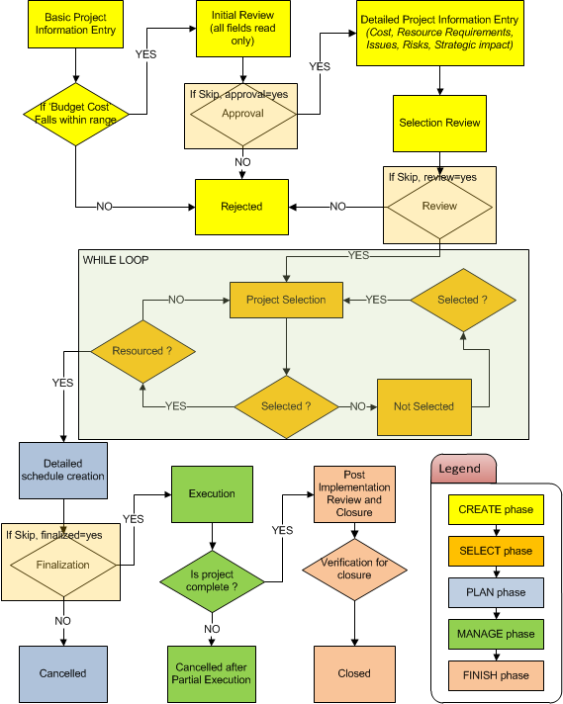
OOB Sample Proposal Workflow
“If budget cost falls within range”, the “Range” for Public Beta is less than 1,000,000. It means that any project that cost less than one million dollars will be automatically approved.

Slide 28
OOB Sample Proposal Workflow
Custom Fields supporting OOB workflow:
Sample Approved Finish Date
Sample Approved Start Date
Sample Areas Impacted
Sample Assumptions
Sample Business Need
Sample Compliance Proposal
Sample Goals
Sample Post Implementation Review Date
Sample Post Implementation Review Notes
Sample Primary Objectives
Sample Proposal Cost
Sample Proposed Finish Date
Sample Proposed Start Date
Lookup Tables supporting OOB workflow:
Sample Areas Impacted
Sample Primary Objective

Slide 29
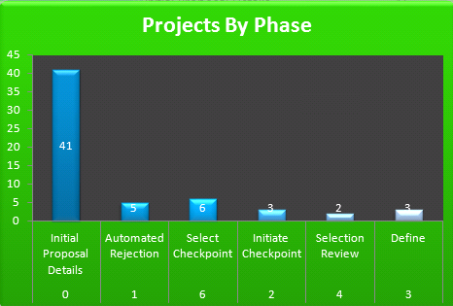
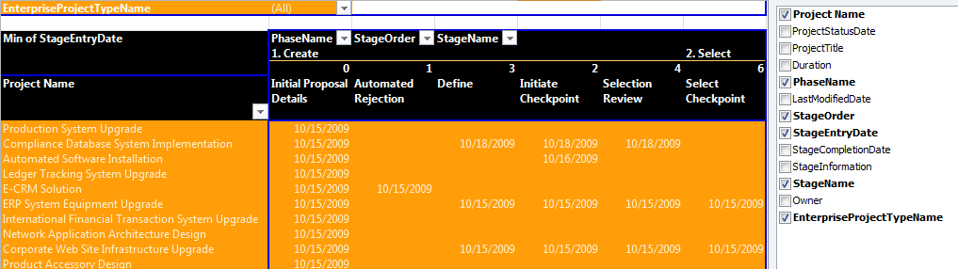
Visualizing Project Workflow
Two OOB Excel report templates are available that help you to visualize Projects as they go through workflow stages and phases:
WorkflowChart
WorkflowDrillDown

Slide 30
Demo - Workflow
Creating Phases
Creating Stages
Creating Workflow
Notes:
Creating Phases:
On the Quick Launch, click Server Settings.
Under Workflow and Project Detail Pages, click Workflow Phases.
Click New Phase
Creating Stages:
On the Quick Launch, click Server Settings.
Under Workflow and Project Detail Pages, click Workflow Stages
Click New Stage and fill in page:
PDP’s will be associated with the Stage
One or more of the PDP’s may be set up to “requires user attention”
Creating the Workflow Logic:
The Workflow Logic is created by programmatically creating the logic that exists between stages. This is done within Visual Studio
Requirements to create Workflows:
Visual Studio 2010 (.Net Framework 3.5)
Must be installed on the same box as Project Server
Administrative rights on:
Server box
SharePoint farm

Slide 31
Project detail pages

Slide 32
Project Detail Page (PDP)
Represents a single web part page in PWA
You create and manage PDPs in SharePoint as you would a typical web part page, adding web parts to create required UI
PDP’s role is to be a “visual container” for data that is driving the project lifecycle
Out Of the Box PDPs:
Post Implementation Review | Project Details
Project Information | Proposal Details
Proposal Schedule | Proposal Stage Status
Proposal Summary | Schedule
Strategic Impact
Notes:
PWA = Project Web Access

Slide 33
Demo - PDP Creation
PWA -> Server Settings -> Project Detail Pages ( Under the “Workflow and Project Detail Pages” heading )
Notes:
PWA -> Server Settings -> Project Detail Pages ( Under the “Workflow and Project Detail Pages” heading )
Click “Documents” tab in Fluent UI
Click “New Document” and fill in page info
Click “Insert” tab , then “Web Part”
Add desired web parts to form PDP

Slide 34
Approvals

Slide 35
Workflow Approvals
PWA -> “Workflow Tasks” in the Approvals section of Quick Launch
The approval process allows decision-makers :
Ability to tightly control which projects continue along in their lifecycle
Provide input to people who are submitting the project proposals
Project Server Workflow Tasks
Items requiring review and approval displayed
Edit Item to comment and make an approval/rejection decision
Approver may be notified by email
“Edit this task” on the message in Outlook
Default WF approvers in PWA (security group):
Portfolio Managers

Slide 36
Approval Configuration
Typically approvals are placed between Stages and Phases
Stages and Phases do not necessarily have to have approvals to proceed
Approval Process is based on SharePoint Server 2010

Slide 37
Approval Configuration ctd.
Create PWA User Group for approvers
Three step process for configuration
Create a Stage for the workflow to enter, where it will wait for an approval
Place an Office Task (SharePoint workflow activity) at the beginning of the stage which will send out tasks to people in the PWA Group for approvers
Create Activities which will wait for the approvals to respond to the tasks and respond according to what the approvals decide on
Notes:
approval is accomplished by doing three tasks:
Create a Stage for the workflow to enter, where it will wait for an approval.
Place an office task at the beginning of the stage which will send out tasks to people in the Approval Group.
Create code which will wait for the approvals to respond to the tasks. And respond according to what the approvals decide on.
Note that the logic behind how approvals are handled is up to the developer. The workflow can wait for all approvals to approve, or it can wait for a majority vote, or it can wait for the first response, and so on.

Slide 38
Demo - Approvals
Demand Management and Workflow - walk through the project lifecycle from user (PM/Approver/Team Member) perspective – connecting the dots
Cover:
Creating the approval process for a proposal
Submitting a proposal
Approving proposals

Slide 39
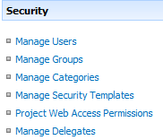
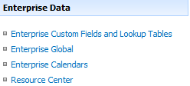
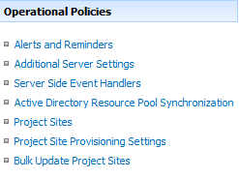
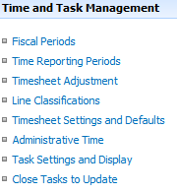
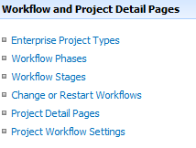
Customizations by Configuration
Available Feature Areas for Custom Configuration:

Slide 40

Customizations Using Developer Tools
Primarily through Custom Web Parts
Custom Web Parts participate in Project Create/Edit experience
Increasingly use SharePoint Services
Like InfoPath Services, Excel Services, Cross List Web Part
New Read/Write APIs for Demand Management
Workflow fully customizable in Visual Studio 2010

Slide 41
Questions?

Slide 42

© 2009 Microsoft Corporation. All rights reserved. Microsoft, Windows, Windows Vista and other product names are or may be registered trademarks and/or trademarks in the U.S. and/or other countries.
The information herein is for informational purposes only and represents the current view of Microsoft Corporation as of the date of this presentation. Because Microsoft must respond to changing market conditions, it should not be interpreted to be a commitment on the part of Microsoft, and Microsoft cannot guarantee the accuracy of any information provided after the date of this presentation. MICROSOFT MAKES NO WARRANTIES, EXPRESS, IMPLIED OR STATUTORY, AS TO THE INFORMATION IN THIS PRESENTATION.

